Slide 1
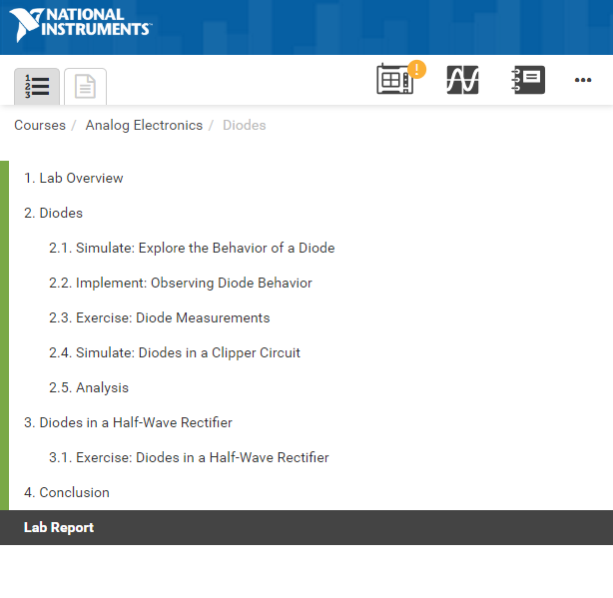
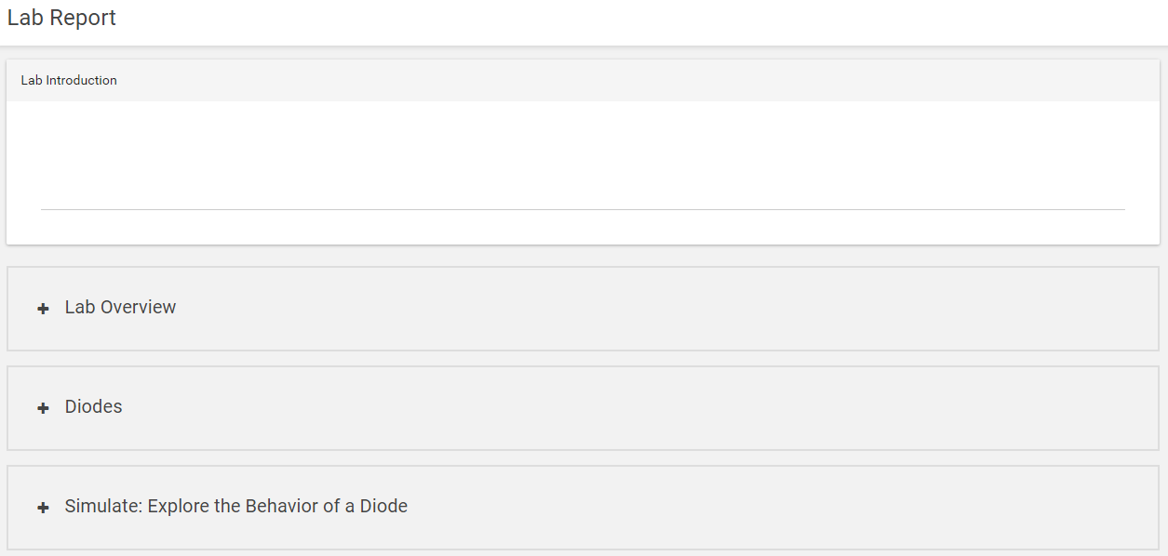
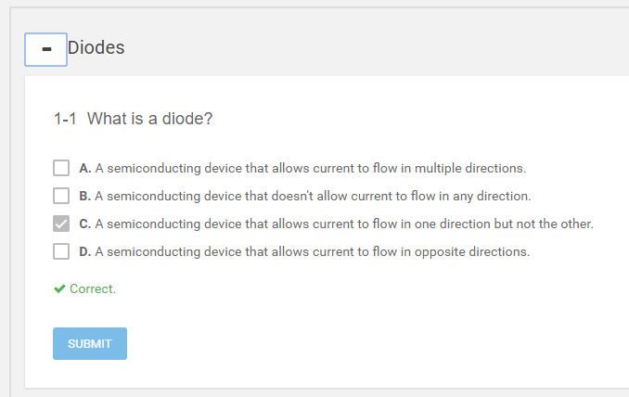
Creating and Submitting a Lab Report
Click on Lab Report in the Table of Contents
Your Lab Report will open in the Main Content Space
1
2
Click on + to expand the inline assessment to view/edit your answer
3
Some inline assessments are automatically marked
4

Slide 2
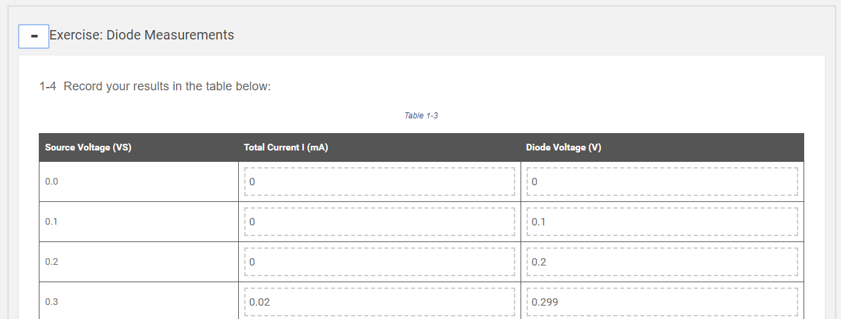
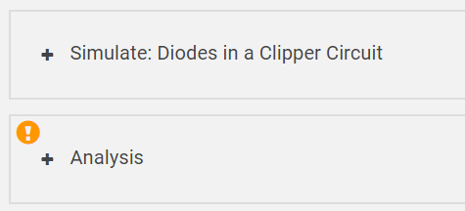
Creating and Submitting a Lab Report
If a question is not complete a ! will be displayed
Some inline assessments may be edited (click submit after any changes)
6
5
You may export your lab report to save or print.
Once expanded, the unanswered question will be highlighted
7
You must resubmit your report if you have made any changes
8

